Slide 1


GROP MRMBERS
1.Eduard gasasira
2.Kevin niyonsenga
3.Elyse Niyonzima

Slide 2
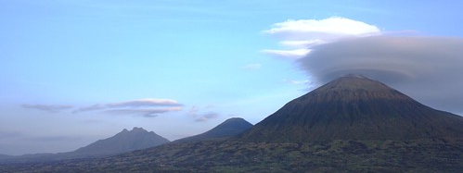
RWANDA HORIZON TOURS
"The gladdest moment in human life is a departure into unknown lands."

Slide 3
users:
Travel Enthusiasts: Individuals or groups planning trips to Rwanda, seeking
wildlife safaris, cultural experiences, or scenic tours.
Tour Operators: Staff members or agents managing bookings, itineraries,
and customer inquiries through the platform.
Corporate Clients: Organizations planning team-building events, retreats, or
business trips in Rwanda.
Travel Agencies: Third-party agencies collaborating with Rwanda Horizon Tours
to offer packages to their clients.
Content Explorers: Users browsing for information about Rwanda’s attractions,
culture, and travel tips

Slide 4
PROBLEMS AND SOLUTIONS
PROBLEM
SOLUTION
Limited Accessibility and Information: Many potential travelers struggle to find comprehensive and reliable information about Rwanda's attractions and travel services.
The web application provides detailed
and interactive content, including
destination highlights,
itineraries, virtual tours, and travel tips,
ensuring users can access all necessary
information in one
place.

Slide 5
CONT…
PROBLEM
SOLUTION
Difficulty in Managing Customer Data and Feedback: Manual systems for handling customer inquiries, bookings, and feedback can lead to inefficiencies and errors
An integrated dashboard for tour operators helps manage bookings, inquiries, and feedback efficiently, improving customer satisfaction and operational effectivenes

Slide 6
CONT…
Lack of Personalization: Many travelers find it challenging to plan trips tailored to their preferences, such as specific interests, durations, or budgets.
Solution: The platform features personalized recommendations, itinerary customization tools, and filtering options, enabling users to create travel plans that suit their unique needs.

Slide 7
HOW IT WILL WORK

Slide 8
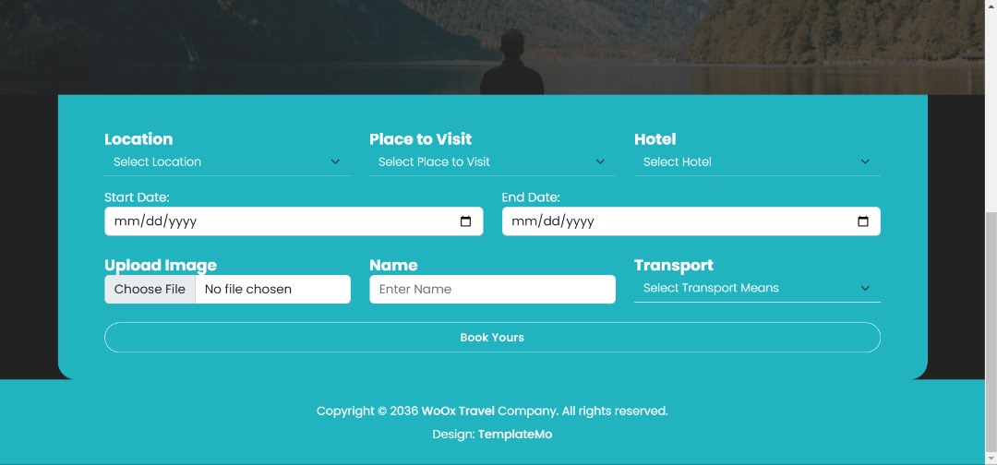
BOOKING PAGE
After selecting a destination, users are directed to the Booking Page, where they can plan the details of their trip. This page includes a form that allows users to provide key travel details, such as the dates of their visit, the type of hotel they prefer, and the transport options they will use during their stay. The booking process is fully customizable, ensuring users can tailor their trip to match their preferences and budget. By handling all aspects of the booking—from accommodations to transportation—the platform simplifies travel planning and makes the experience more convenient for users.

Slide 9
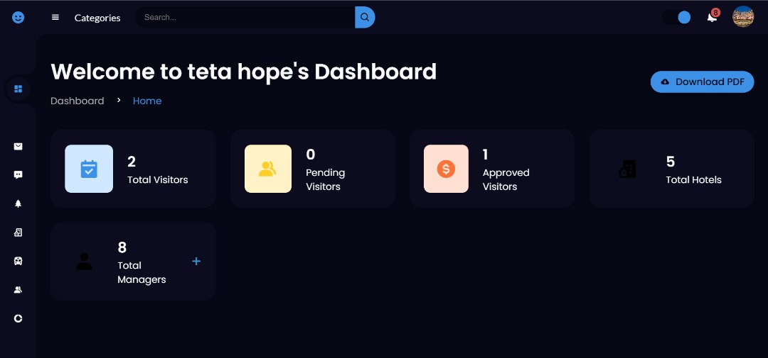
Dashboard page
The Dashboard Page is designed for site managers to oversee and manage the platform’s operations. To access this section, managers must log in with their credentials. Once inside, the dashboard provides a detailed overview of the platform’s activities, including information submitted by users. Key features include:
Pending Visitors: A list of visitors whose bookings require approval.
Approved Visitors: A record of visitors whose bookings have been confirmed.
Total Hotels: A summary of all the hotels available on the platform.
Total Visitors: A real-time count of all visitors who have used the platform.
The dashboard also allows managers to modify or update user bookings and other details, as we tell the dashboard, data are all dynamics they fetched and sent to /from database straigthly.

Slide 10
CONCLUSION
The Rwanda horizon tours project is an innovative platform that combines ease of use with robust management tools. By showcasing Rwanda’s breathtaking destinations and streamlining the booking process, it encourages more visitors to explore the country’s natural beauty, cultural heritage, and historical landmarks. Meanwhile, the addition of a managerial dashboard provides administrators with the tools needed to maintain, oversee, and optimize the platform’s operations. Together, these features create a comprehensive solution for both tourists and managers, boosting Rwanda’s tourism sector while ensuring a seamless experience for all stakeholders.

Slide 11

FOR YOUR KIND ATTENTION!!
WELCOME TO “RWANDA HORIZON TOURS WEBSITE”

